Slide 1

THE GANG
ADIDAS TECH SPORTS: “REMAKE”

Slide 2
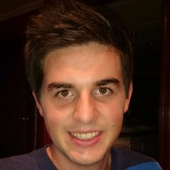
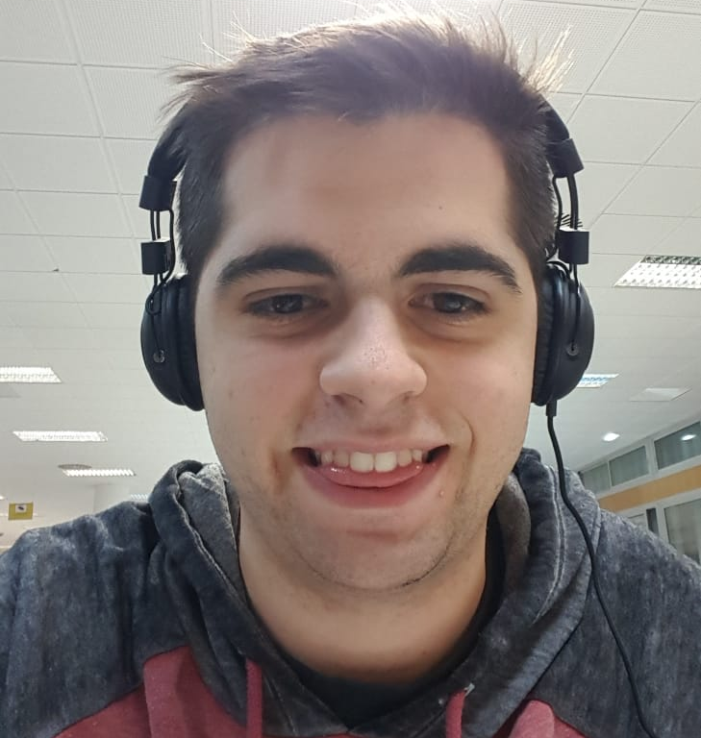
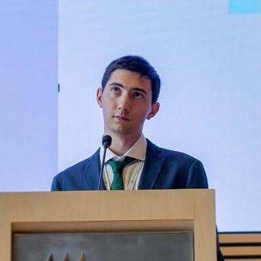
TEAM MEMBERS
Albert Merino
Computer Science Engineer
Oscar López
Student of Computer Science Engineering
Josep Maria Salvia
Student of Double Degree in Computer Science and Business Management

Slide 3

DATA MINING

Slide 4

DATA REVISION

Slide 5

COMMUNICATION

Slide 6
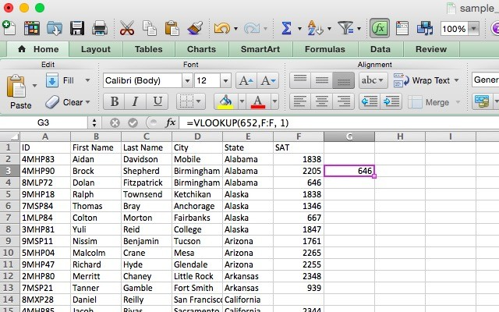
IDENTIFY THE PROBLEM

Slide 7
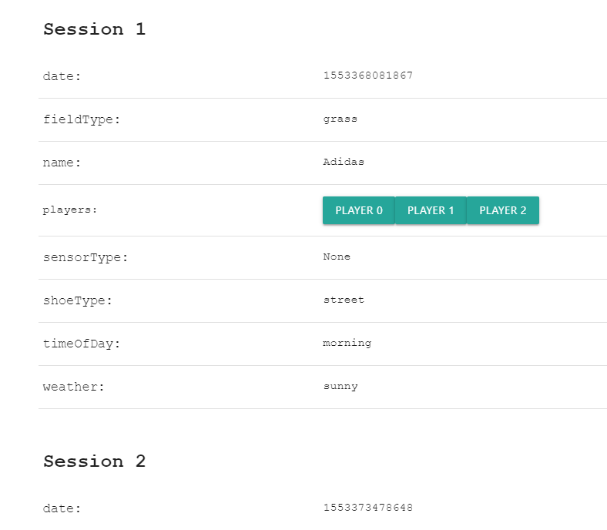
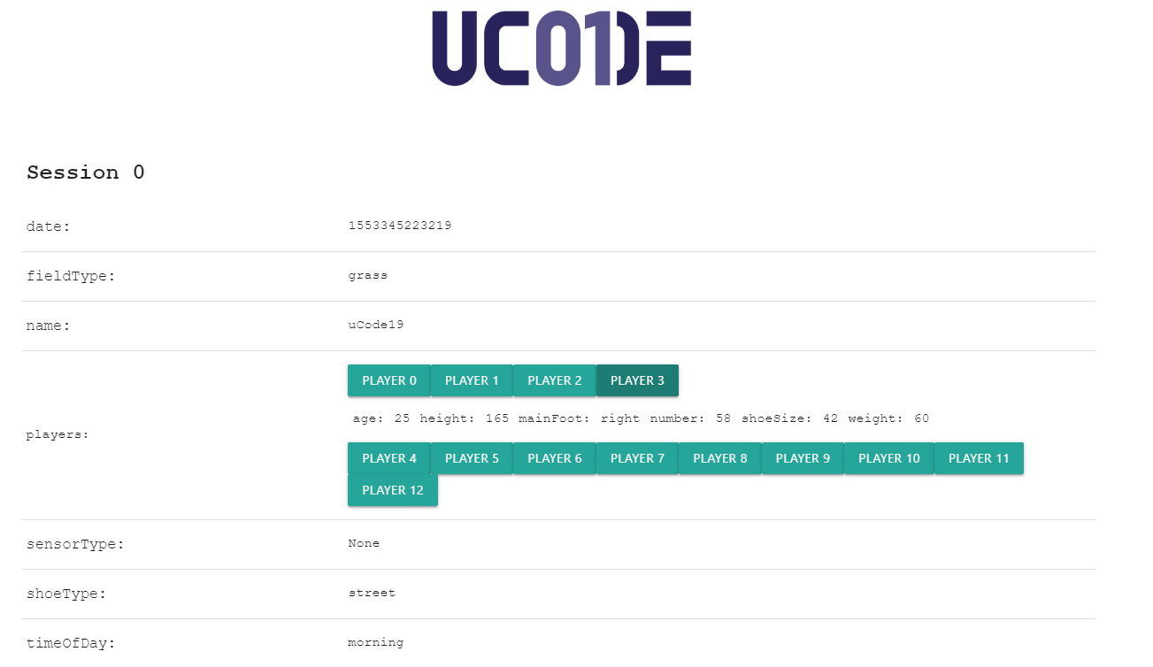
OUR SOLUTION - PART 1

Slide 8
OUR SOLUTION - PART 2
Foto aquí
Foto aquí

Slide 9
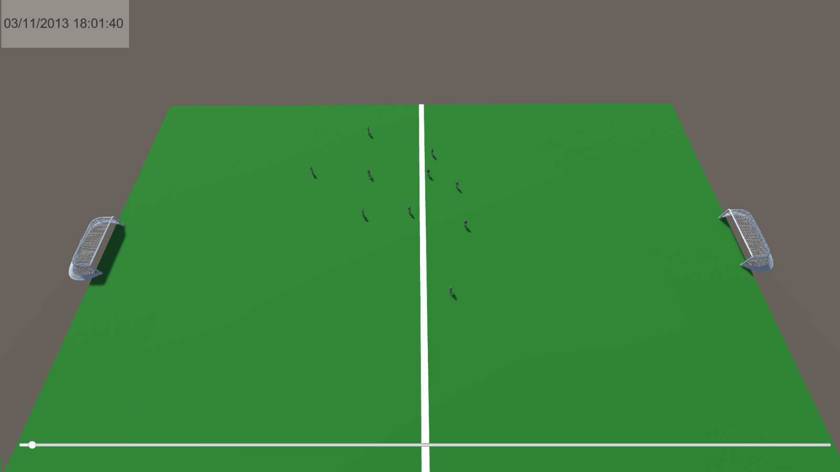
DEMO

Slide 10

Q
A
&

Slide 11
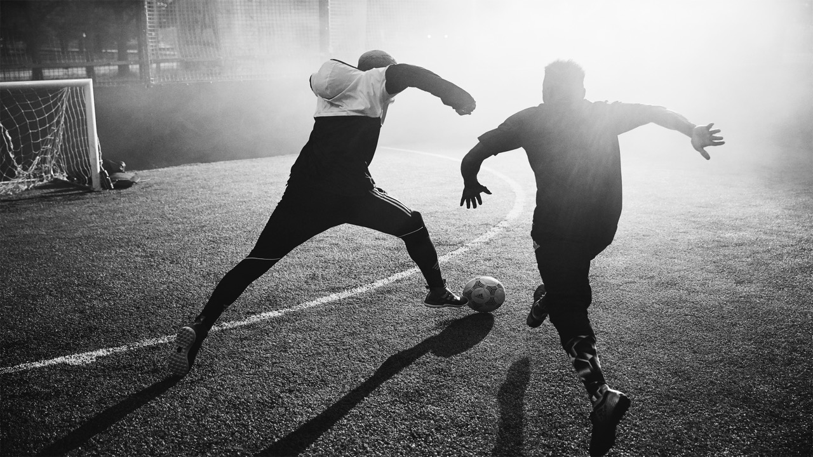
THANK YOU!

